Slide 1
Simulation Modeling and Performance Evaluation
Lecture 03
Systems, Models, and Their Classifications
Muhammad Mahbub Alam, PhD
Professor
CSE Department, IUT

Slide 2
Continuous- vs. Discrete-state systems
Continuous-State System
The state space X is a continuous set
State equations are representing by differential equation
Mathematical tools and solution techniques are available
Discrete-State System
The state space X is a discrete set
State equations are usually logical statements
If something happens and current state is x, next state will be x’
Mathematical representation and solving them are usually complex

Slide 3
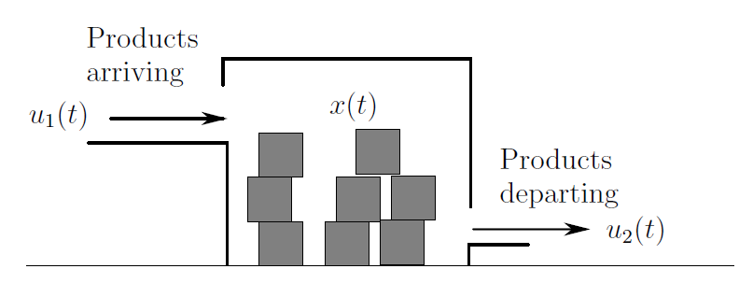
Discrete-State System: Example
State variable is x(t)
State space is a set of non-negative integer, X = {0,1,2..}
Output equation, y(t) = x(t)
Inputs are function of time defined as

Slide 4
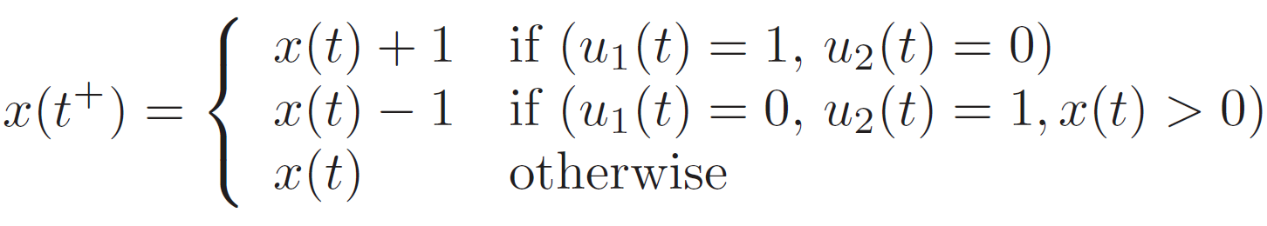
Discrete-State System: Example (Contd.)
State transitions of the system are
u₁(t) = 1, u₂(t) = 0 » x(t) = x(t) + 1
u₁(t) = 0, u₂(t) = 1 » x(t) = x(t) – 1
u₁(t) = 0, u₂(t) = 0 » x(t) = x(t)
State equation: derivative is not possible. Let t⁺ denote the time instant just after t.

Slide 5
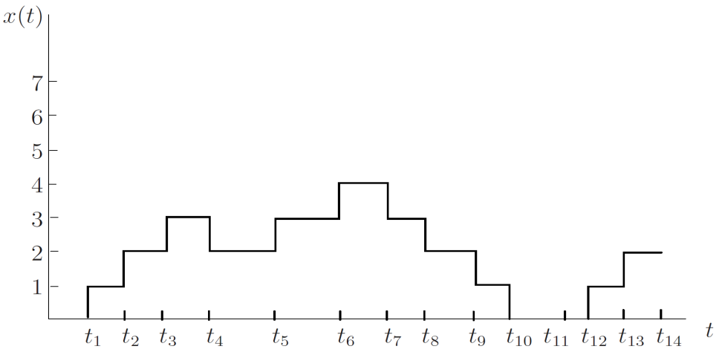
Discrete-State System: Example (Contd.)
Product arrives (i.e., u₁(t) = 1, at
t₁, t₂, t₃, t₅, t₆, t₁₂ and t₁₃
Truck arrives (i.e., u₁(t) = 1, at
t₄, t₇, t₈, t₉, and t₁₀

Slide 6
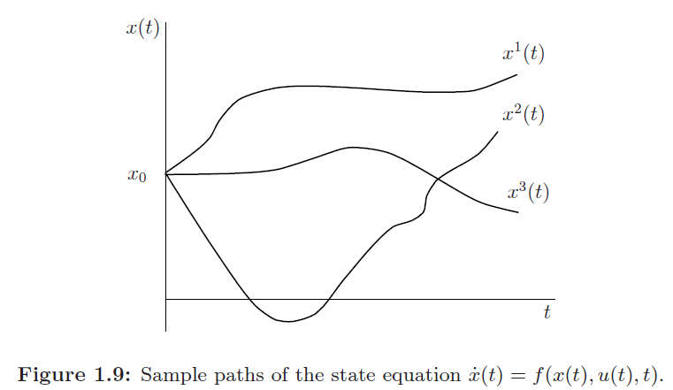
Simple Paths of Dynamic Systems

Slide 7
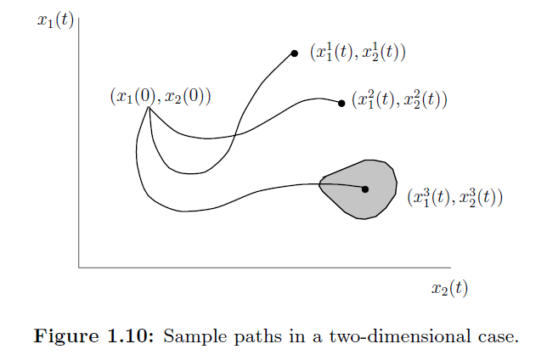
Simple Paths of Dynamic Systems (Contd.)

Slide 8
Deterministic vs. Stochastic Systems
Stochastic Systems: A system is defined as stochastic if at least one of its output variables is a random variable.
State of the system is a random/stochastic process
State at time t is a random vector, and its prob. Distribution function is evaluated
Deterministic Systems: A system is deterministic, if none of its output variables are random.
Given u(t), for all t ≥ 0, x(t) can be evaluated

Slide 9
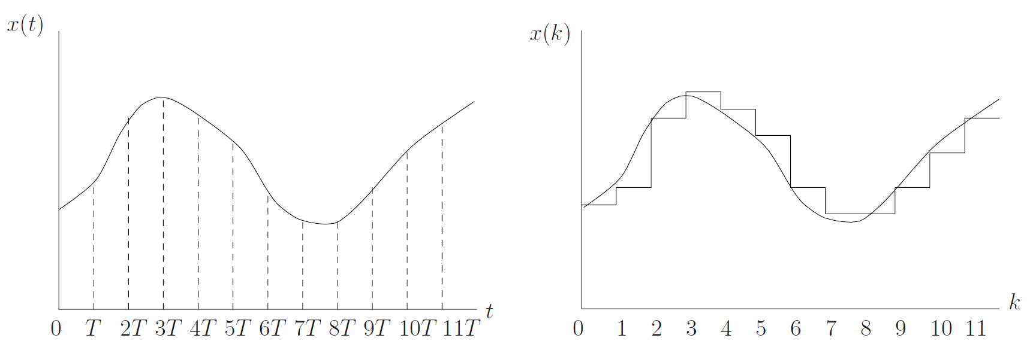
Discrete-Time Systems
In a discrete time model, the time line is thought of as a sequence of intervals defined by a sequence of points
t₀ < t₁ < …. < t_{k} < ….
All intervals are of equal length, T, where
t_{k+1} – t_{k} = T

Slide 10
Concept of Events
State space is described by a discrete set like {0,1,2, …}
State transitions are only observed at discrete points in time
Transitions are associated with special actions
Such actions are termed as ‘Events’
Somebody Presses a button
Computer goes down
Usually state transitions are associated with events

Slide 11
Discrete-event Simulation
A discrete-event system is defined by
Stochastic – at least some of the system state variables are stochastic
Dynamic – the evolution of the system state
Discrete-event – system state changes are associated with events that occurs at discrete time

Slide 12
Time-Driven vs. Event-Driven Systems
Continuous state systems are usually time driven
State changes continuously with time
Discrete state systems change states at certain points in time, where an event occurs
If the system is time driven, at each clock tick, either an event occurs or no event occurs
Transitions are synchronized with clock
If the system is event driven, at certain time instant an event occurs, and state changes
Events define a time instant of it occurrence
Transitions are asynchronous

Slide 13
Properties of Discrete Event Systems
The state space is a discrete set
The state transition mechanism is event-driven
State evolution depends entirely on the occurrence of asynchronous discrete events
The sample path of the system jumps from one state to another whenever an event occurs
System status can be represented as sequence of timed events.
(e₁, t₁), (e₂, t₂), (e₃, t₃), (e₄, t₄), (e₅, t₅), (e₆, t₆), (e₇, t₇)

Slide 14
Examples of Discrete Event Systems
Queueing systems
Computer systems
Communication systems
Manufacturing systems
Inventory systems
Traffic systems
Database systems

Slide 15
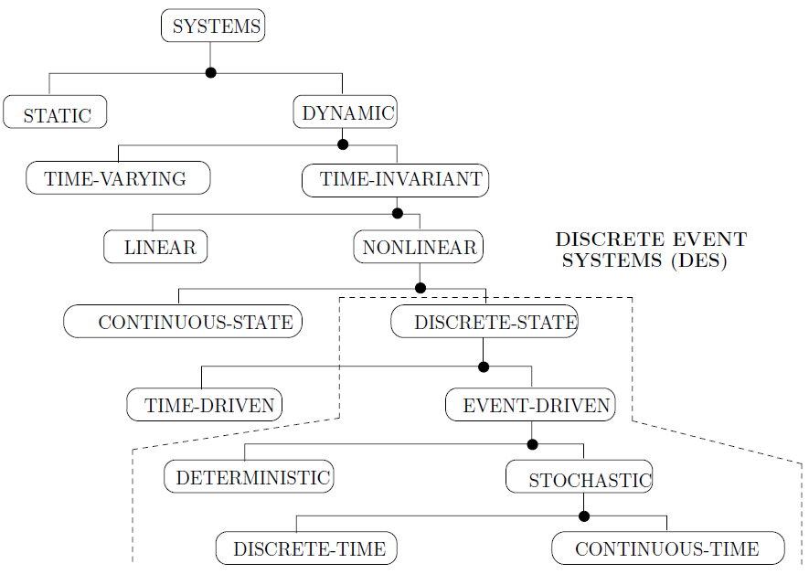
Taxonomy of System Classification

Slide 16
Models
A model is a simplified representation of some real object or physical situation which serves a particular purpose
Abstract representation of systems
A number of approximations
Mathematical description of the system
Input-output model
State space-model

Slide 17
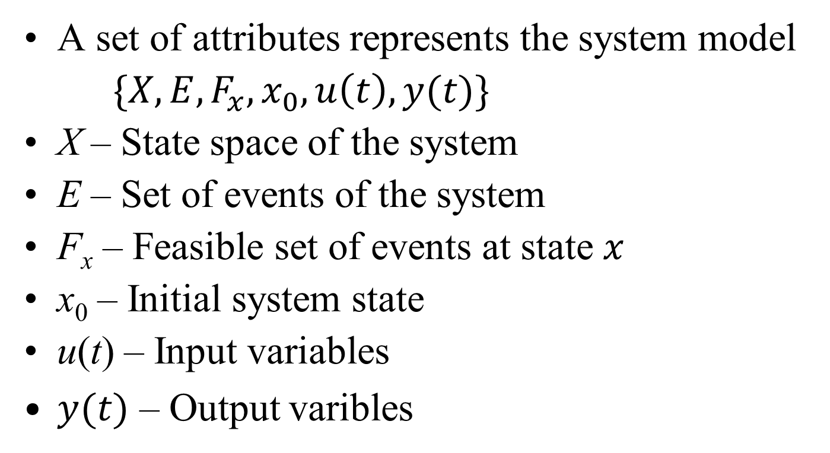
State-Space Models
A set of attributes represents the system model
$\{X, E, F_{x}, x_{0}, u\left(t\right), y(t)\}$
X – State space of the system
E – Set of events of the system
F_{x} – Feasible set of events at state $x$
x₀ – Initial system state
u(t) – Input variables
$y(t)$ – Output varibles

Slide 18
State-Space Model (contd.)
Two sets of equations are derived
Set of state equations
Set of output equations
Input data modeling
Collection of data from real system
Identification of statistical properties
Distribution of input data
Output data analysis
Decision making

Slide 19
Simulation Development Life Cycle

Slide 20
Step 1: Goals and Objectives
Given – Problem statement
Goals and objectives
Simple Boolean decision
Need of an additional server
Numeric decision
# of server requires for satisfactory performance
Qualitative decision
Customer satisfaction
Usually helps to identify the output variables

Slide 21
Step 2: Conceptual Model
Usually, an informal model
Describes the system in an abstract way
Identifies the important variables
Remove the irrelevant variables with negligible impact
Intellectually challenging but rewarding

Slide 22
Step 2: Conceptual Model (Contd.)
Sketch of a system, or a system diagram
Identification of the state variables
How they are related
How they interact with each other
Identification of the events
Identification of the input variables
Finding the output variables
Relation among the variables

Slide 23
Step 3: Specification Model
Mathematical representation of the system
Define the state equations
Define the output equations
Mathematical derivation for the output variables
Estimate of the output variables
Identification of the state space
Identification of the feasible event set at a state
Input data modeling
Collection of input data
Statistical analysis of input data
Probabilistic distribution of input data

Slide 24
Step 4: Computational Model
Algorithm development
Simulation clock, and a procedure to update the simulation clock
An initialization procedure for the system
A scheduler is designed which maintains the feasible events
Trigger the next event
Calls the simulation clock update procedure
Calls the event handler of the next event
Associated with each event, a set of actions are involved – event handler executes them
Algorithm development for the event handler of each event

Slide 25
Step 4: Computational Model (Contd.)
Decision has to be made
Object oriented design
Structural design
UML diagram of the system
Use-case diagram for the system
Sequence diagram
Flow charts for the routines

Slide 26
Step 5: Verification
Checking that the
computational Model is consistent with the specification model
Program is consistent with the computational model
Algorithm design and program writing are correct
Test run of the simulation program with known data
May be desk run
Repeat steps 4 and 5, as long as not verified

Slide 27
Step 6: Validation
Is the model consistent with the system
Model is correctly representing the system
Otherwise, go to step 2
Simple but popular technique
Collect output data from real system for known input
Run the simulation with the same input
Collect output data from simulation
Consult an expert
If expert cannot identify the simulation and real data
Simulation is correct

